Slide 1
帳單Draft API(docx)

Slide 2
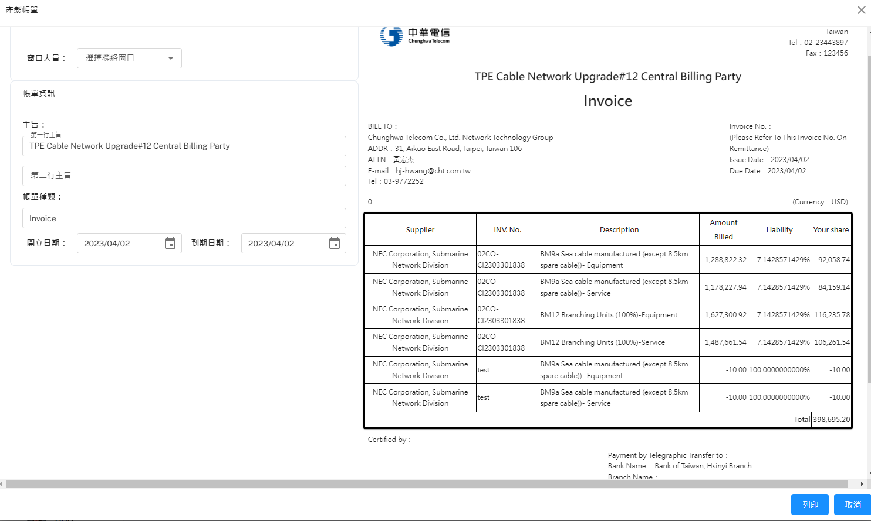
POST(帳單Draft)
POST Body
{
"BillMasterID": 1,
"UserID": "chang_ty",
"IssueDate": "2023/04/01",
"DueDate": "2023/04/30",
"WorkTitle": "Construction #11",
"InvoiceName": "",
}

